Slide 1
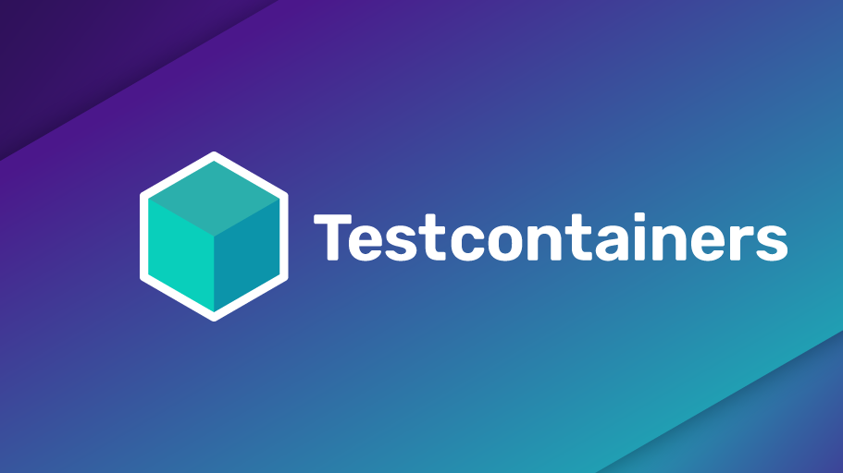

Slide 2
Table of contents
What is it?
Who is already using it?
What languages is it available in?
What are the prerequisites?
Why is it useful?
Features walk-through
That part where I ask for questions, and you are silent for more than 20 seconds

Slide 3

What it is?
Open source library that allows developers to create and manage docker containers from their own projects.

Slide 4










Who is already using it?

Slide 5
What languages is it available in?
java
javascript
python
.Net
go
rust

Slide 6
What are the prerequisites?
Docker (of course)
used language

Slide 7
Why is it usefull?
Every docker related setup that was previously done separately (in a bash or something similar) can now be written using the preferred programming language.
Can be used in various testing stages:
integration
functional
end to end

Slide 8
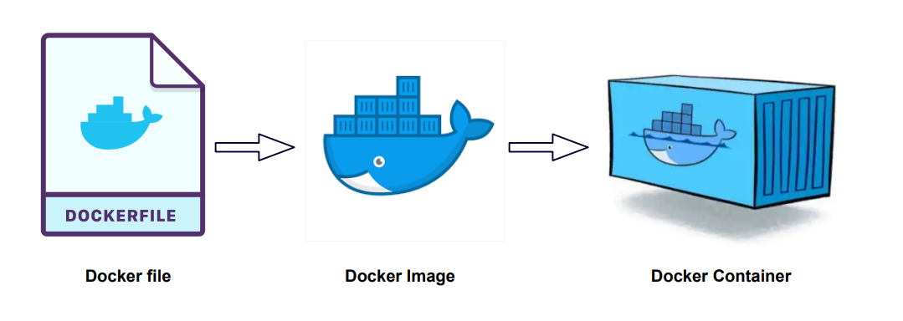
Docker

Slide 9
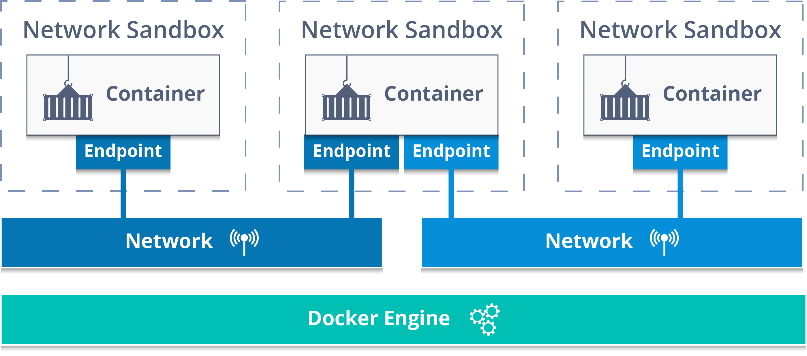
Docker
https://www.testcontainers.org/features/creating_container/

